Slide 1

Streamline Your Infrastructure Deployment with GitOps and the Pulumi Operator
Sam Cogan

Slide 2





About Me
Sam Cogan
Solution Architect – WTW
Microsoft Azure MVP
samcogan.com
@samcogan
sam-cogan

Slide 3
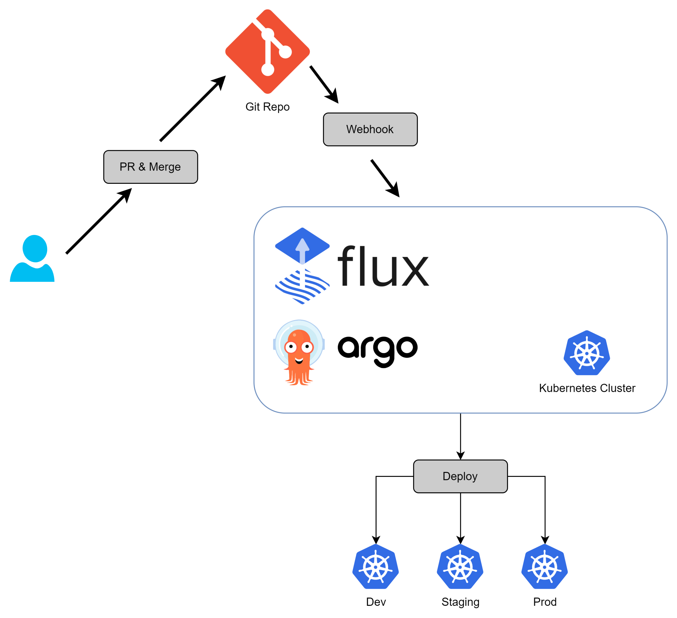

Slide 4
